Slide 1

ARTIFICIAL INTELLIGENCE APPLICATION PROJECT
Predictive Maintenance Using Machine Learning

Slide 2

GROUP Members
Name: CONFIDENCE IKEMSINACHI AHUEKWE
Student ID: 991714953
Name: IFIOK-OBONG SUNDAY IKPE
Student ID: 991734876
Name: HENRY NNADOZIE ECHEJI
Student: 991730116
Date: April 10th, 2024.

Slide 3

INTRODUCTION
Predictive maintenance is a critical aspect of modern manufacturing that aims to optimize maintenance schedules, reduce downtime, and improve operational efficiency. It is also a proactive approach that uses data analytics and machine learning techniques to predict equipment failures before they occur.

Slide 4

OBJECTIVE
The objectives of exploring predictive maintenance using machine learning are rooted in addressing the inefficiencies and challenges prevalent in traditional maintenance practices. They include:
Improve Operational Efficiency
Reduce Maintenance Costs
Enhance Asset Reliability
Ensure Safety and Compliance
Foster Data-Driven Decision Making
Enable Predictive Insights

Slide 5

Background
Addressing these challenges requires a holistic approach that encompasses data collection, preprocessing, feature engineering, model development, and deployment. Moreover, it entails collaboration between domain experts, data scientists, and maintenance personnel to ensure the successful implementation and adoption of predictive maintenance solutions.
In various industries, equipment downtime due to unexpected failures poses a significant challenge, leading to production losses, increased maintenance costs, and potentially compromising safety standards.

Slide 6
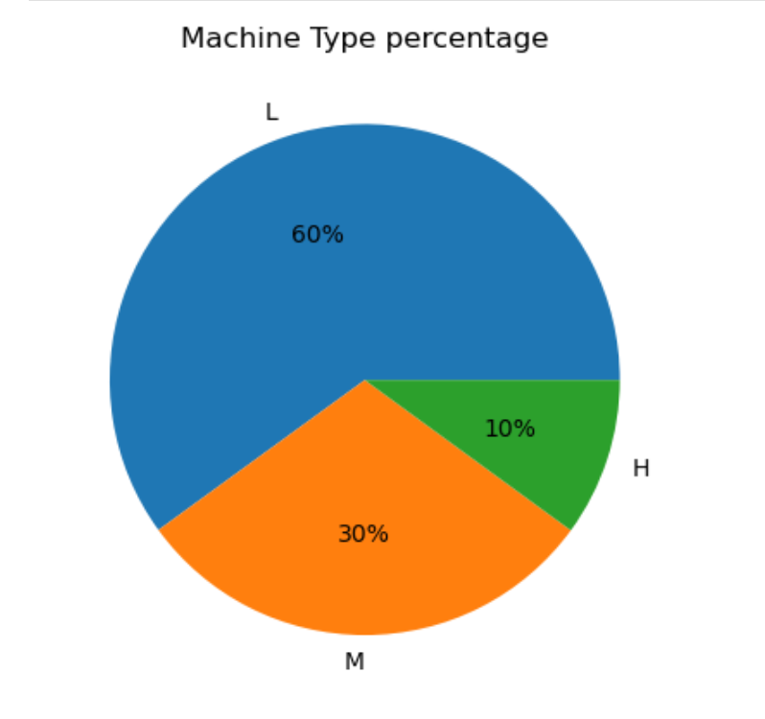
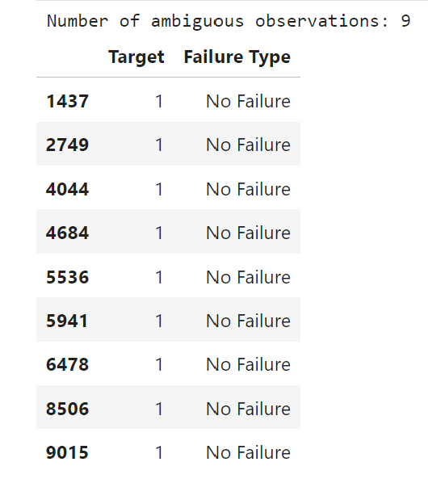
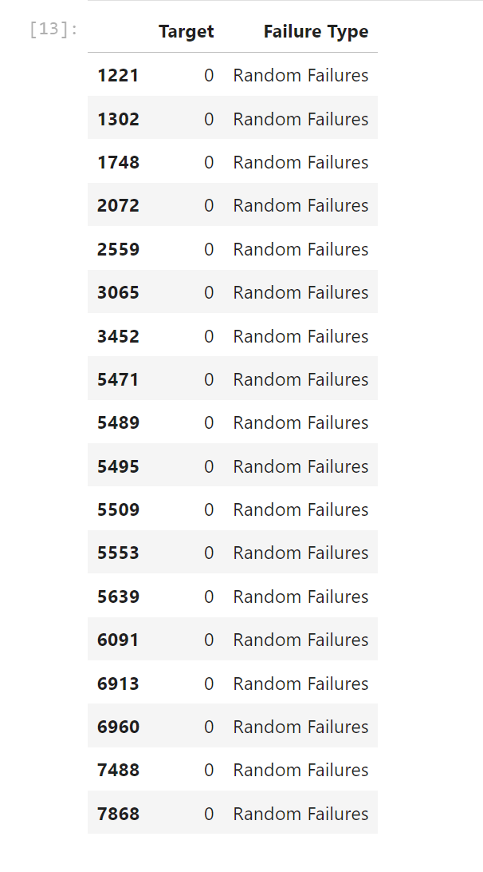
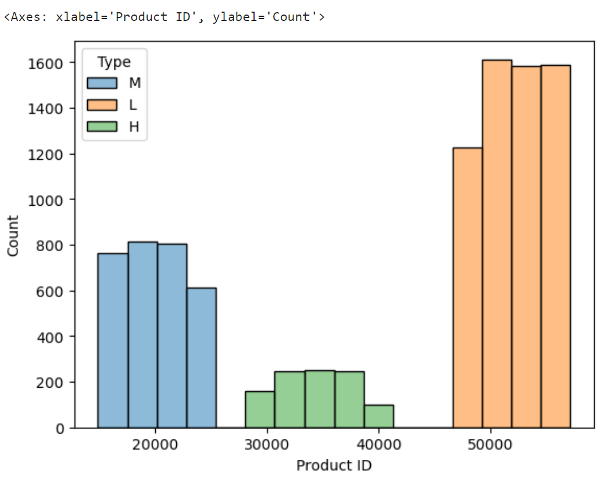
IMPLEMENTATION
Data Collection and Preprocessing
Feature Selection and Engineering
Model Development and Evaluation
Integration with Existing Systems
Performance Monitoring and Optimization
Documentation and Knowledge Transfer
Scalability and Generalizability

Slide 7
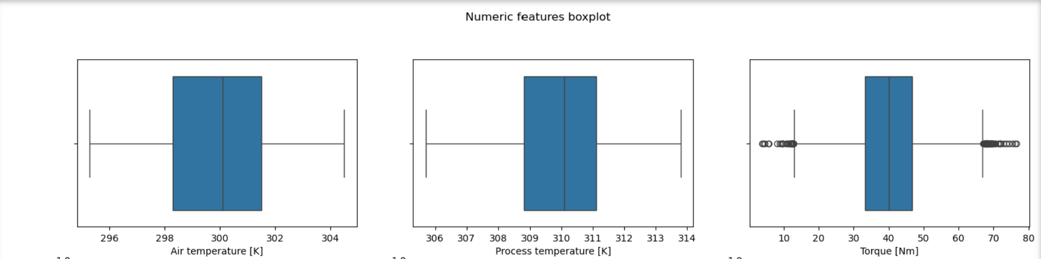
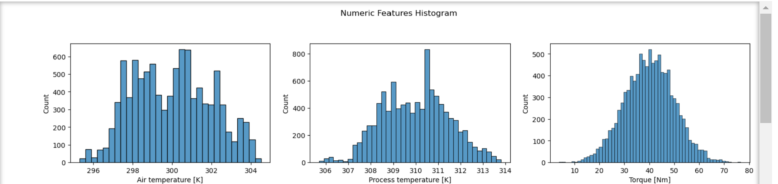
Outliers inspection

Slide 8
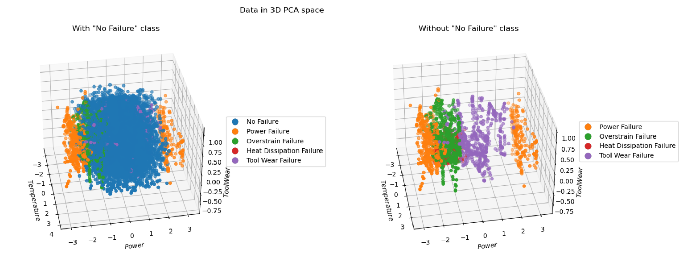
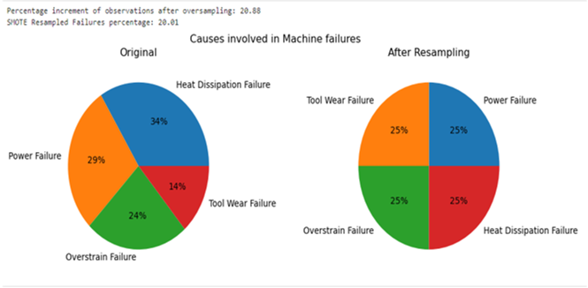
Visualisation
As one can expect, the cases of Machine Failure mainly concern low-quality machines, then those of medium quality, and only a few times those of high quality. This difference is accentuated when the number of observations of non-functioning machines is (artificially) increased.

Slide 9
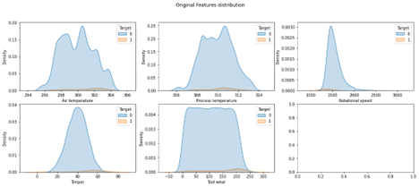
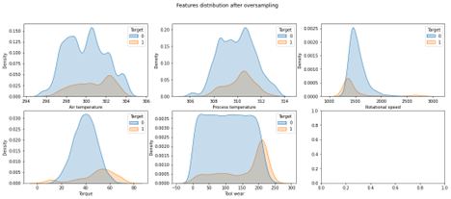
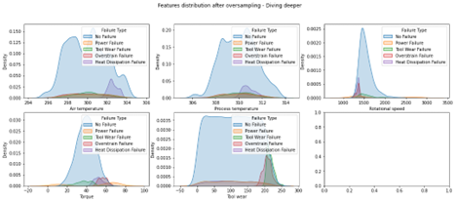
Comparison after resampling
The first thing we can observe is that the data augmentation was performed successfully, as the feature distribution for faulty instances have not been significantly distorted. It should also be noted that in Rotational Speed, Torque and Tool Wear the observations relating to failures have a density peak in extreme zones of the distribution. This implies that the outliers are not to be imputed to mistakes in the dataset building but rather to the natural variance of the same.

Slide 10
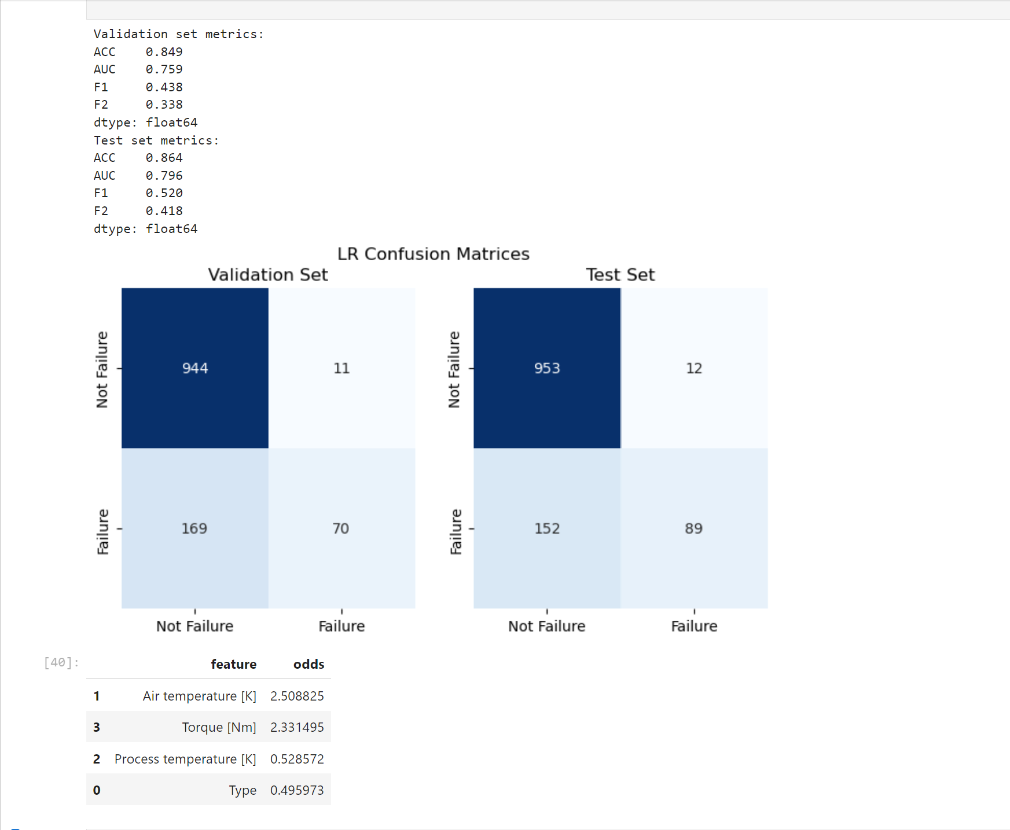
IMPLEMENTATION: Logistic Regression Benchmark
The odds of logistic regression allow us to understand how the model is working. In particular, an unrealistically high importance is given to Torque and Air temperature. This is mainly due to the natural variance in these features, which is especially high when looking only at the failure cases and tends to "deviate" from the model. We also expect greater reliability of the odds values when we apply logistic regression to the multiclass task since the effects that are spread here appear to be localized around certain types of failures.

Slide 11
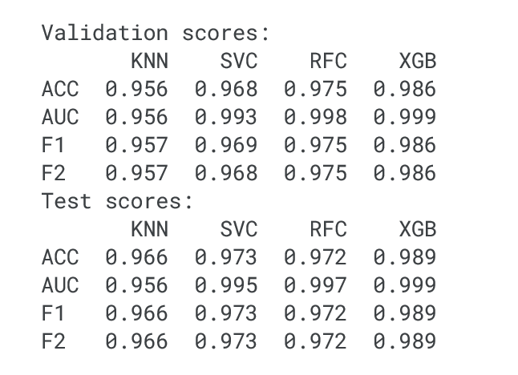
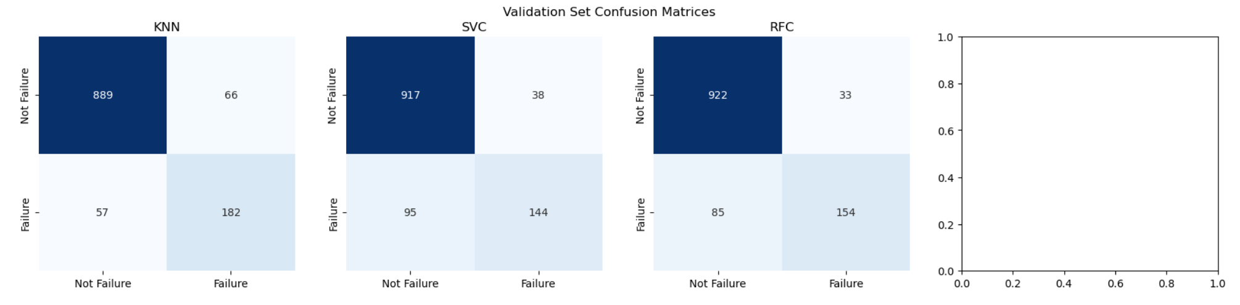

Model Implementations
By comparing the results obtained, we see that K-NN is the model that performs the worst. Despite this, we cannot exclude it a priori, as it still reaches high values for the metrics and, moreover, gives an immediate response. So, we can use it whenever we need to get an idea quickly about the situation and, then apply other models when we have more time.
All other models perform better than the benchmark and they obtain high values for the chosen metrics both for validation and test set. SVC and RFC’s performances are very similar each other the training phase, one can choose which model he prefers according to his needs.

Slide 12
Conclusions & Recommendations
In conclusion, the predictive maintenance system using machine learning algorithms has proven to be effective in reducing downtime, optimizing maintenance schedules, and improving overall operational efficiency in manufacturing.
Recommendations for future research include:
advanced analytics techniques
leveraging IoT data for predictive maintenance
exploring predictive maintenance applications in diverse industrial contexts.

Slide 13

Thank You
QUESTIONS AND ANSWER
This Photo by Unknown Author is licensed under CC BY-SA

